Slide 1








Project Quality Management
1

Slide 2



What Is Quality?
Table of content
What is Quality?
The importance of Quality
Consequences of Poor Quality
Quality vs Grade
What Is Project Quality Management?
How Do We Manage Quality?
Case Studies
Quality Management Process
Plan Quality Management
Manage Quality
Control Quality
Quality Management in Agile
Summary

Slide 3


Course Objectives
After this course, trainee will be able to:
Understand what quality is and how
important it is.
Know the processes required for quality
management
Understand different tools and techniques
used in quality management processes

Slide 4
WHAT IS QUALITY?

Slide 5


What is Quality?
The International Organization for Standardization (ISO) defines quality as “the degree to
which the project fulfills requirements” (ISO9000:2000)
Other experts define quality based on:
Conformance to requirements: the project’s processes and products meet written
specifications
Fitness for use: a product can be used as it was intended

Slide 6
The importance of Quality
In 1986 and 1987, 4 hospital patients died and 2 others with lifelong injuries after receiving fatal doses of radiation from a Therac 25 machine after a software problem caused the machine to ignore calibration data.
In one of the biggest software errors in banking history, Chemical Bank mistakenly
deducted about $15 million from more than 100,000 customer accounts
A quality problem of Ecommerce system on production that the system automatically sends mail to 10,000 users that impact to business of the customer and FPT Software.
Quality saves Life, Money and Fame

Slide 7
Consequences of Poor Quality
Lost Business
Customer stop using products or services
Liability
Damages or injuries resulting from poor
quality
Poor Quality
Low Productivity
More rework or scrap. An increase in input
does not increase the output
High Costs
Such as failure costs incurred by defective
parts or products or faulty services

Slide 8

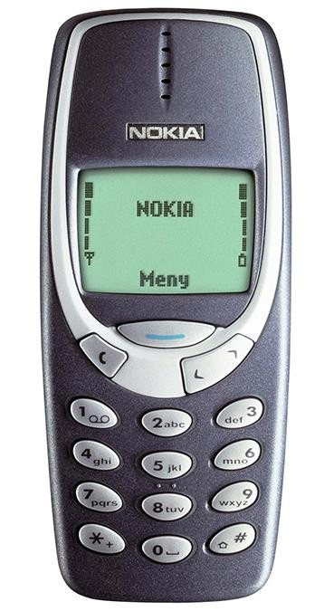
Quality vs Grade
Quality: a measure of how the product conforms to the requirement / fit for the expected
use level.
Grade: a measure of which level the product is expected to perform.
» Low quality is always a problem; low grade may not be.

Slide 9
What is Project Quality Management?
Do the Right Things
Do Things Right
Do the right things
right
Plan Quality
Manage Quality
Control Quality
Focus on setting Quality objectives and necessary processes
Ensure the team is following organizational policies, standards, and processes as planned to produce the project’s deliverables
Ensure the deliverables are correct and meet the planned level of quality; and to find the source of problems and recommend ways to address them

Slide 10
HOW DO WE MANAGE QUALITY?

Slide 11
Case Studies
» Case 1: You’re appointed to be a project manager. Senior manager needs internal estimation so he knows how many efforts the project will be sponsored. You request project technical lead to provide effort. What can be risks?
» Case 2: The fact is Developer often thinks that quality is tester’s responsibility. Right after coding, he passes code to tester without unit test. What will you do to change this mindset?

Slide 12
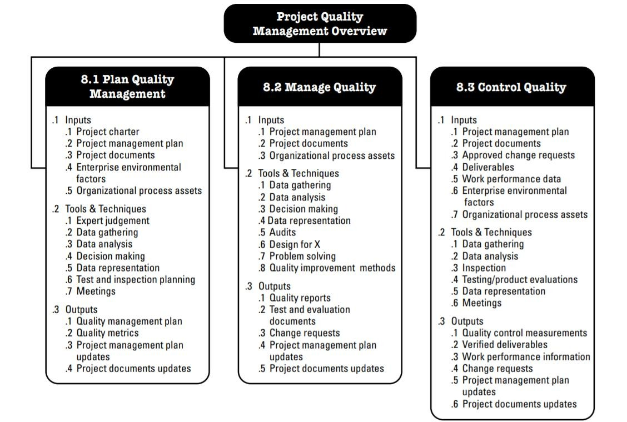
Quality Management Process

Slide 13
Plan Quality Management
Identify quality requirements and/or standards for the project and its deliverables, and document how the project will demonstrate compliance with quality requirements and/or standards.
Provides guidance and direction on how quality will be managed and verified
throughout the project.
INPUTS
TOOLS & TECHNIQUES
OUTPUTS
Project charter
Project management plan
Project documents
Enterprise environmental
factors
Organizational process
assets
Expert judgment
Data gathering
Data analysis
Decision making
Data representation
Test and inspection
planning
Meetings
Quality management
plan
Quality metrics
Project management plan
updates
Project documents plan
updates

Slide 14
Output: Quality Management Plan
Describes how applicable policies, procedures, and guidelines will be implemented to
achieve the quality objectives.
It describes the activities and resources necessary for the project management team to
achieve the quality objectives set for the project.
Quality management plan may include (but is not limited):
» Quality standards (quality metric)
» Quality objectives
» Quality roles and responsibilities
» Project deliverables and acceptance criteria
» Quality control and quality management activities
» Quality tools
» Major procedures: such as dealing with nonconformance, corrective actions, and
continuous improvement.

Slide 15
Output: Quality Management Plan
Acceptance Criteria:
Category | Product | Technique
Definition of Done (based on Test Coverage, Code Review report & Defect Criteria) | Test Case | 100% test coverage. Performance Test, Monkey Test, Abnormal Test, Duration Test and Regression Test will be executed according defined plan for each sprint.
 | Source Code | 100% source code must be reviewed. 100% source code be scanned by Blackduck, SonarQ, Coverity.
 | Defect Criteria | 100% of Show Stopper/Must Fix defects must be resolved/closed. Zero obvious defects. <10% complicated defects.
Sprint Acceptance Criteria |  | 100% User Story is done (including coding, testing, and fixing bugs/defects and committed source code) as committed in Sprint backlog. No show stopper/ blocker defect. The demonstration outputs are approved by Client PO.
Project Acceptance Criteria |  | 100% scope and deliverables are delivered on time as committed. No show stopper/ blocker defect. Approved by Client PO.

Slide 16
Output: Quality Management Plan
Code Review Strategy:
Review Areas | Reviewer | Review Type | Review Method | Completion Criteria | Output
Coding, Naming convention | TL/Dev | Using tool Self review | Using tool Sonar Code review tool (provided by FPT) | 100% critical issues must be fixed | Review report
Functionalities/ Code logic | TL/Dev | Group review | Using code reviewed checklist (customized by team) Using common defects checklist | 100% critical issues must be fixed | Review report
Security Code | TL/Dev | Using tool Group review | Using Coverity (provided by FPT) Using best practice Security Code Review checklist (customized by team) | 100% critical issues must be fixed | Review report
Code review activities will be taken before each sprint’s deliverables
Review report will be shared with Client
CI/CD will be implemented for automating code analyst

Slide 17
Output: Quality Management Plan
Test Strategy:
Test Type | Objective | Technique | Using Tool | Completion Criteria | Output
Function Test | Ensure proper target-of- test functionality, including navigation, data entry, processing, and retrieval. | Black box test technique will be used Test leader creates checklists for common features to support review and test execution Testers will create test scenarios against User Stories approved by customers Testers execute test based on test scenarios and make reports. Common defects will be collected for improvement checklists. | Manual Test Automation script (optional) | All planned tests have been executed. All identified defects have been addressed and closed | Test report
Regression Test | Verify part of software to make sure that the modification does not cause errors other part | Reuse the set of functional test cases to test a modified module Amount of test cases (depend on each sprint plan) are randomly select from existing Test case | Manual Test Automation Script (optional) | All selected test cases are performed and passed | Test report

Slide 18
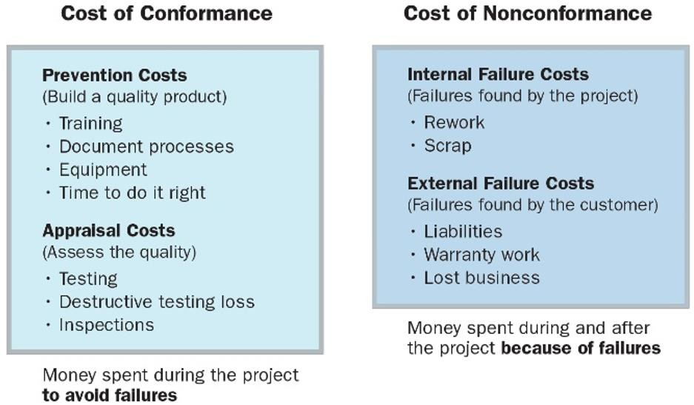
Tools & Techniques: Data analysis (cont)
Cost of Quality (COQ): all cost
incurred over the life of a product.
» Prevention costs: Preventing non-conformance to the requirements.
» Appraisal costs: Appraising conformance to the requirements.
» Failure costs (Int/Ext): Failing to
meet requirements (reworks).

Slide 19
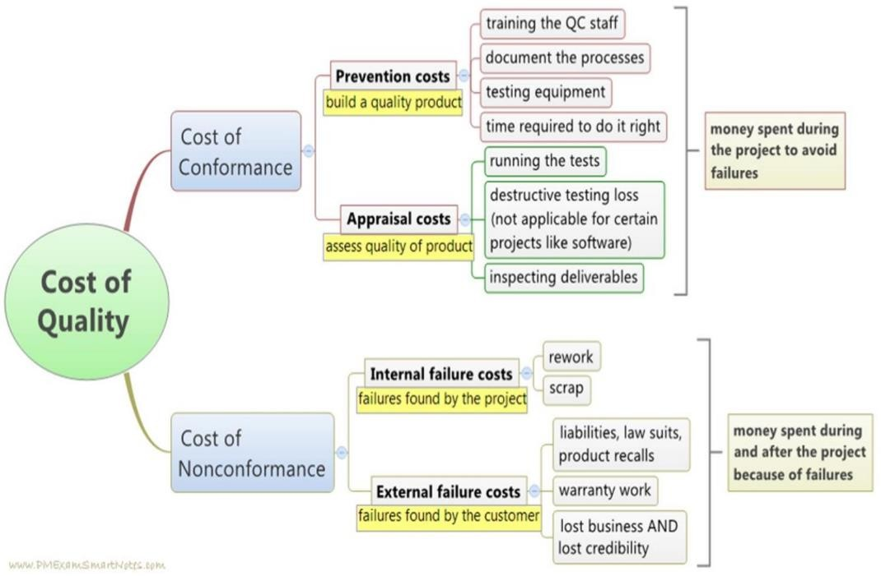
Tools & Techniques: Data analysis (cont)

Slide 20
MANAGE QUALITY

Slide 21
Manage Quality
Manage Quality is the process of translating the quality management plan into executable quality activities that incorporate the organization’s quality policies into the project.
Increases the probability of meeting the quality objectives as well as identifying ineffective processes and causes of poor quality.
INPUTS
TOOLS & TECHNIQUES
OUTPUTS
Project management plan
Project documents
Organizational process assets
Data gathering
Data analysis
Decision making
Data representation
Audit
Design for X
Problem solving
Quality improvement
methods
Quality report
Test and evaluation
documents
Change requests
Project management plan
updates
Project documents plan
updates

Slide 22
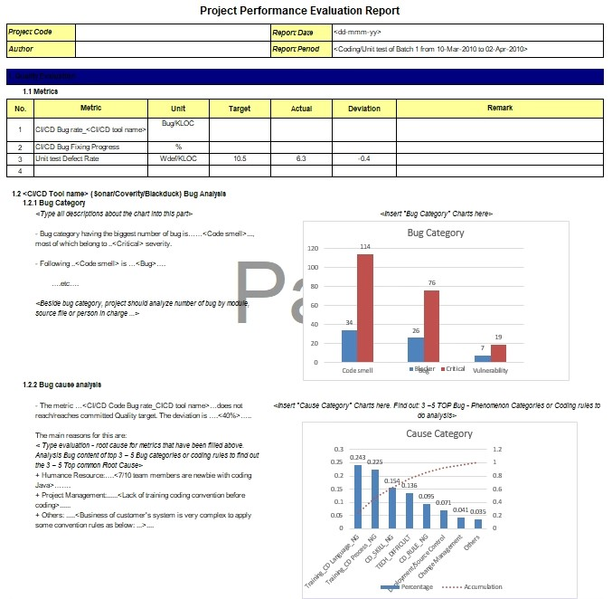
Output
Quality Reports
Quality management issues escalated by
the team
Recommendations for process, project &
product improvements
Corrective actions recommendations
Summary of findings from the Control
Quality process
Test & Evaluation Documents
Evaluate the achievement of quality
objectives
Change requests
It related to corrective, preventive, and
defect repair are made.

Slide 23
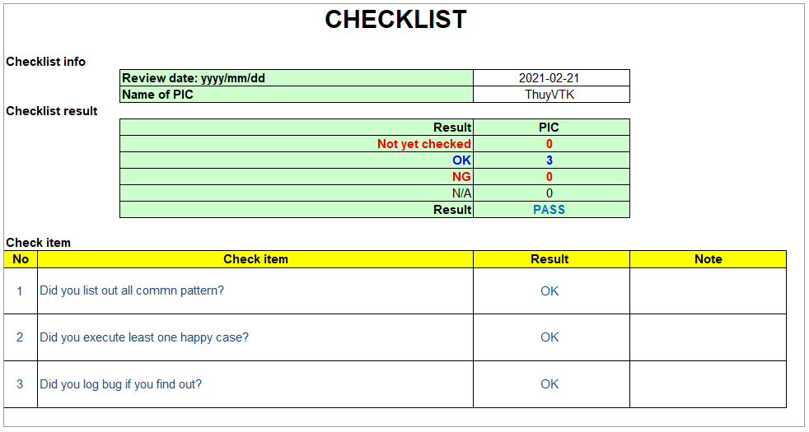
Tools & Techniques: Data gathering
Checklists: Verify that a set of required steps has been performed or to check if a list of
requirements has been satisfied

Slide 24
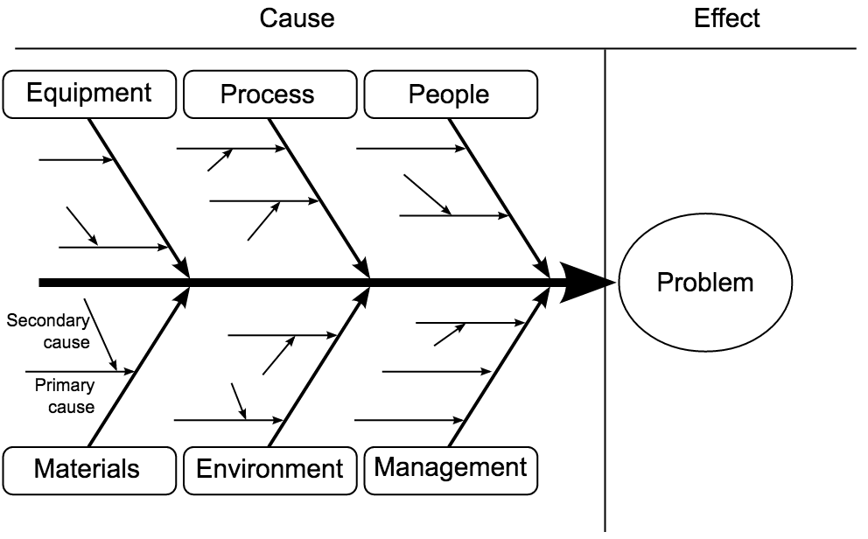
Tools & Techniques: Data representation
Cause-and-effect diagrams: are also known as fishbone diagrams, why-why diagrams, or Ishikawa diagrams
» It traces complaints about quality
problems.
» Help you find the root cause of a
problem.
» Uses brainstorming
Identify problem
Work out major factors involved
Identify possible cause
Analyze diagram
» Major causes are further investigated
» 5 whys technique ➔ root cause of the
Quality

Slide 25
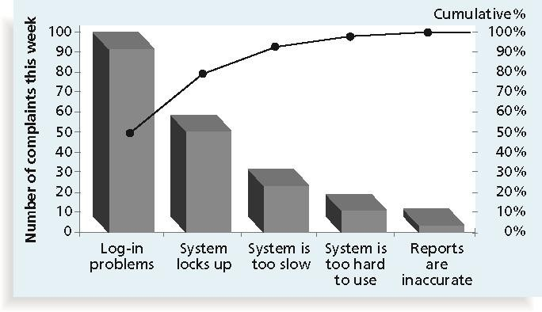
Tools & Techniques: Data representation
Pareto Diagram: is a histogram that can help you identify & prioritize problem areas.
Pareto analysis (80-20 rule), means that, 80% of problems are often due to 20% of the
causes.

Slide 26
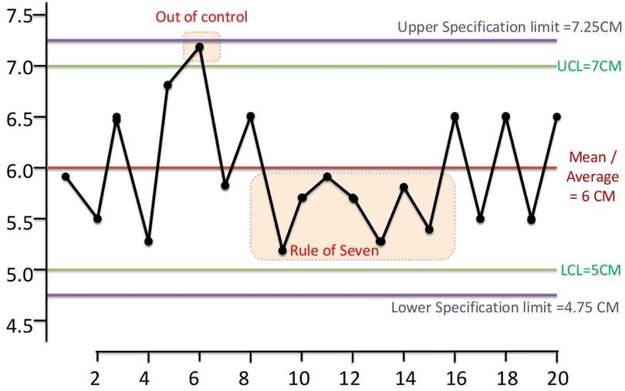
Tools & Techniques: Data representation
Control Chart: Determine whether a process is in control or out of control.
Prevent defects, rather than to detect or reject them.

Slide 27
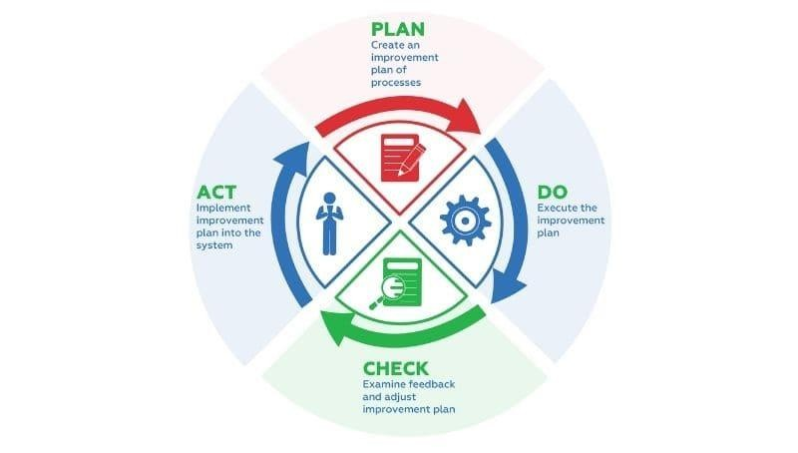
Tools & Techniques (cont)
Problem Solving:
» Defining the problem
» Identifying the root-cause
» Generating possible solutions
» Choosing the best solution
» Implementing the solution
» Verifying solution effectiveness
Quality Improvement Methods:
» PDCA (Plan-do-check-act)

Slide 28
Case Study
» A project team member comes to the project manager during project execution to tell him that they feel the project cannot meet its quality standards. As the project manager, what will you do?

Slide 29
CONTROL QUALITY

Slide 30
Control Quality
Monitoring and recording results of executing quality activities to assess performance and recommend necessary changes.
Identifying causes of poor process/product quality and recommend actions.
The key benefit of this process is verifying that project deliverables and work meet the
requirements specified by key stakeholders for final acceptance.
INPUTS
TOOLS & TECHNIQUES
OUTPUTS
Project management plan
Project documents
Approved change requests
Deliverables
Work performance data
Enterprise environmental
factors
Organizational process
assets
Data gathering
Data analysis
Inspection
Testing/product evaluation
Data representation
Meetings
Quality control
measurements
Verified deliverables
Work performance information
Change requests
Project management plan
updates
Project documents plan updates

Slide 31
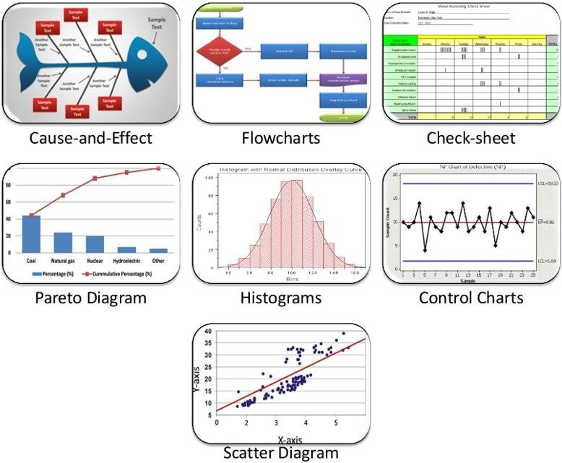
Tools & Techniques: Data representation
Seven Basic quality tools: described in manage quality section.

Slide 32
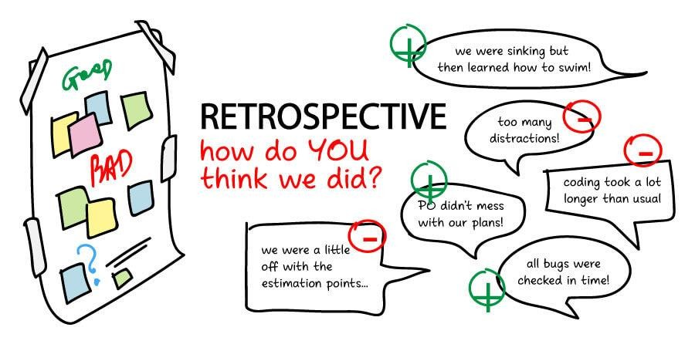
Tools & Techniques: Meetings
Approved change requests review:
» All approved change requests should be reviewed to verify that they were
implemented as approved.
» This review should also check that partial changes are completed and all parts have
been properly implemented, tested, completed, and certified.
Retrospectives/lesson learned: A meeting held by a project team to discuss:
» Successful elements in the project/phase
» What could be improved
» What to incorporate in the ongoing project and what in future projects
» What to add to the organization process assets.

Slide 33
CONSIDERATIONS FOR AGILE/ADAPTIVE ENVIRONMENT

Slide 34
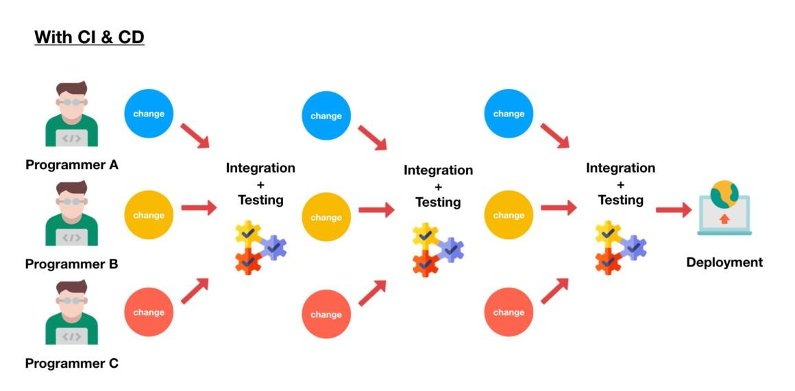

Considerations for Agile/Adaptive Environment
Frequent quality and review steps built in throughout the project rather than toward the end of the project.
Focus on small batches of work to uncover inconsistencies and quality issues earlier in the project life.
Recurring retrospectives regularly check on the effectiveness of the quality processes.

Slide 35
SUMMARY

Slide 36






Summary
Plan Quality Management
Seven Basic quality tools
Cost of Quality
Plan - Do - Check - Act

